Slide 1
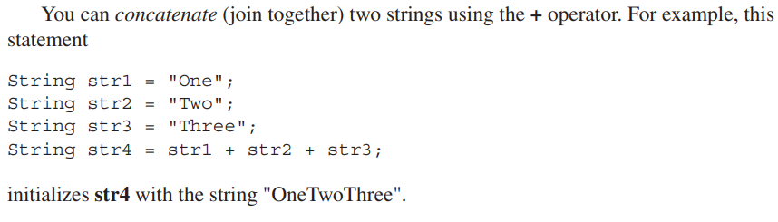
More Data Types and Operators

Slide 2

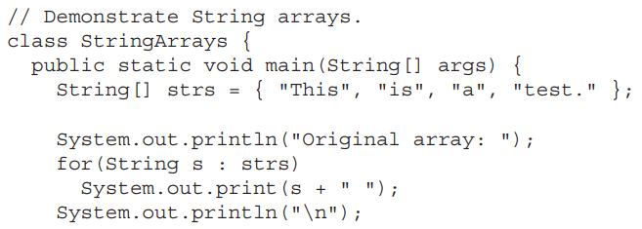
More Data Types and Operators

Slide 3
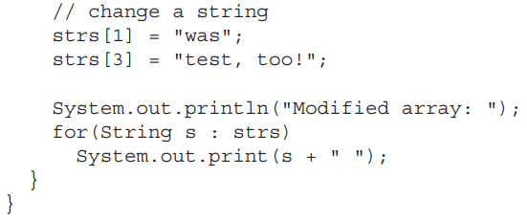
More Data Types and Operators

Slide 4
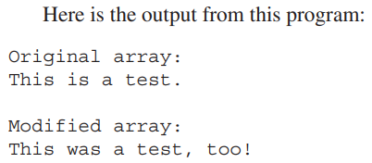
More Data Types and Operators

Slide 5

More Data Types and Operators
The contents of a String object are immutable. That is, once created, the character sequence that makes up the string cannot be altered.
This restriction allows Java to implement strings more efficiently.
To fully understand why immutable strings are not a hindrance, we will use another of String’s methods: substring( ).

Slide 6

More Data Types and Operators
The substring( ) method returns a new string that contains a specified portion of the invoking string.
The form of substring( ) that we will be using is shown here:

Slide 7
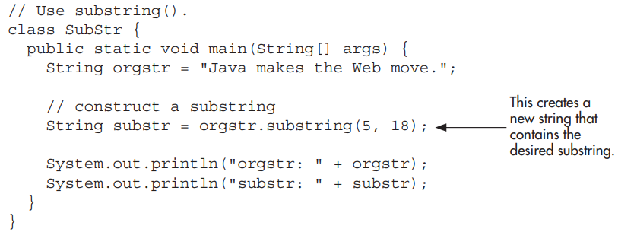
More Data Types and Operators
Here is a program that demonstrates substring( ) and the principle of immutable strings:

Slide 8

More Data Types and Operators

Slide 9
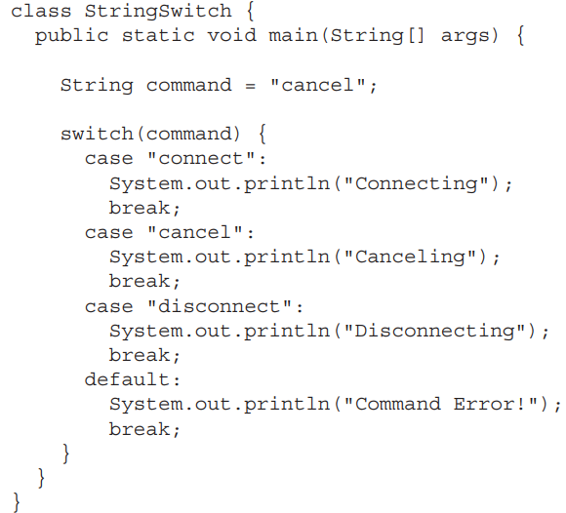
More Data Types and Operators

Slide 10

More Data Types and Operators

Slide 11
More Data Types and Operators
A feature called local variable type inference was added to the Java language.
To begin, let’s review two important aspects of variables.
First, all variables in Java must be declared prior to their use.
Second, a variable can be initialized with a value when it is declared.

Slide 12
More Data Types and Operators
Furthermore, when a variable is initialized, the type of the initializer must be the same as (or convertible to) the declared type of the variable.
Thus, in principle, it would not be necessary to specify an explicit type for an initialized variable because it could be inferred from the type of its initializer.
Beginning with JDK 10, it became possible to let the compiler infer the type of a local variable based on the type of its initializer, thus avoiding the need to explicitly specify the type.

Slide 13

More Data Types and Operators
To support local variable type inference, the context-sensitive keyword var was added to Java.
To use local variable type inference, the variable must be declared with var as the type name and it must include an initializer.
Consider the following statement that declares a local double variable called avg that is initialized with the value 10.0:

Slide 14

More Data Types and Operators
Using type inference, this declaration can also be written like this:
its type is inferred as double because the initializer 10.0 is of type double.

Slide 15
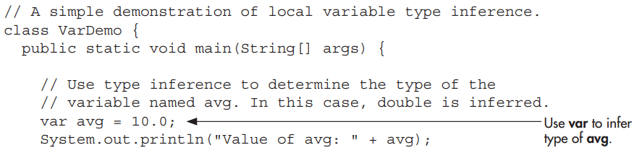
More Data Types and Operators

Slide 16
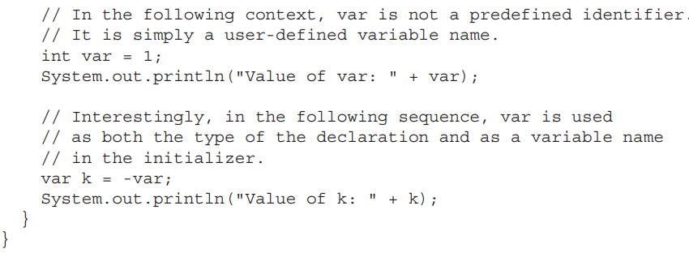
More Data Types and Operators

Slide 17
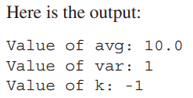
More Data Types and Operators

Slide 18
More Data Types and Operators
The preceding example uses var to declare only simple variables, but you can also use var to declare an array.
Notice that neither var nor myArray has brackets. Instead, the type of myArray is inferred to be int[ ].

Slide 19

More Data Types and Operators
Furthermore, you cannot use brackets on the left side of a var declaration. Thus, both of these declarations are invalid:
In both cases, the use of the brackets is wrong because the type is inferred from the type of the initializer.

Slide 20

More Data Types and Operators
The following declarations use type inference to declare two String variables called myStr and mySubStr:

Slide 21

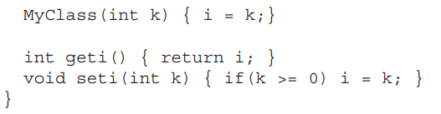
More Data Types and Operators

Slide 22
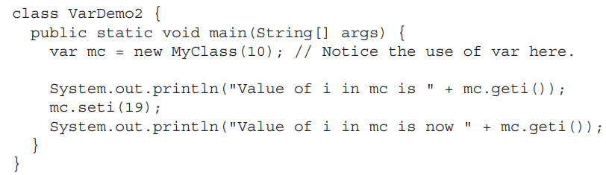

More Data Types and Operators

Slide 23
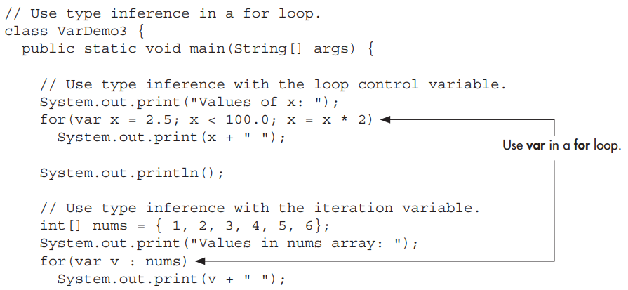
More Data Types and Operators

Slide 24
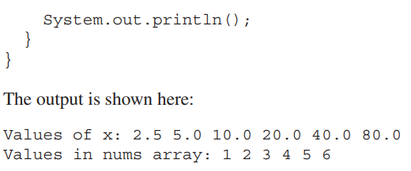
More Data Types and Operators

Slide 25

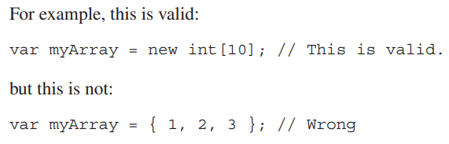
More Data Types and Operators
Although you can declare an array type using var, you cannot use var with an array initializer.
As mentioned earlier, var cannot be used as the name of a class.

Slide 26
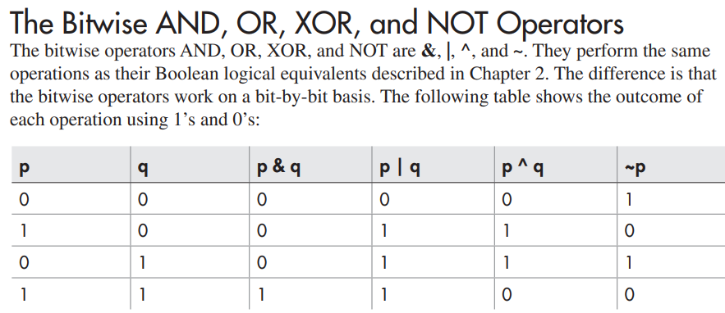
More Data Types and Operators

Slide 27
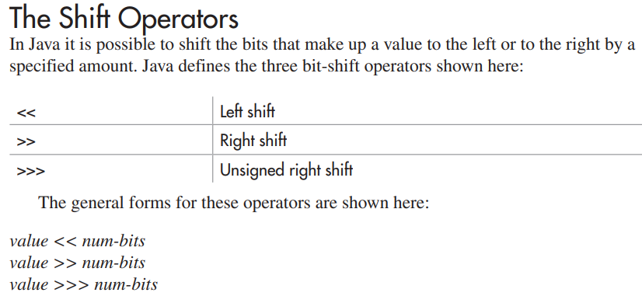
More Data Types and Operators

Slide 28
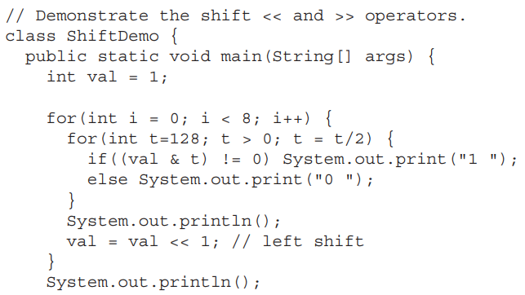
More Data Types and Operators

Slide 29
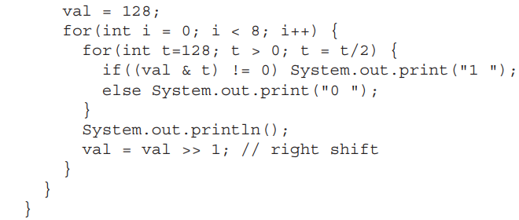
More Data Types and Operators

Slide 30
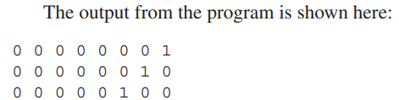
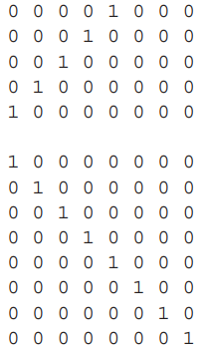
More Data Types and Operators

